Slide 1

To Configure RIP OSPF & BGP using Packet Tracer
Prof. D. T. Bodake(SKNCOE)

Slide 2
Learning Objectives
Upon completion of this lab, you will be able to:
Cable a network according to the Topology Diagram.
• Perform basic configuration tasks on switch & router.
Configure and activate interfaces.
Configure RIP OSPF BGP routing on all routers.
Verify RIP OSPF & BGP routing using show command.
Prof. D. T. Bodake(SKNCOE)

Slide 3
Static Routing
Typically used in hosts
  Enter subnet mask, router (gateway), IP address
  Perfect for cases with few connections, doesn’t change much
    E.g. host with a single router connecting to the rest of the Internet
Internet
IP: 128.1.1.100
R1
H1
H2
H3
For H1
Next Hop:
128.1.1.100
Prof. D. T. Bodake(SKNCOE)

Slide 4
Dynamic Routing
Most routers use dynamic routing
  Automatically build the routing tables
  As we saw previously, there are two major approaches
    Link State Algorithms
    Distance Vector Algorithms
First some terminology
AS = Autonomous System
  Contiguous set of networks under one administrative authority
  Common routing protocol
  E.g. University of Alaska Statewide, Washington State University
  E.g. Intel Corporation
  A connected network
    There is at least one route between any pair of nodes
Prof. D. T. Bodake(SKNCOE)

Slide 5
Routing in an AS
IRP = Interior Routing Protocol
  Also IGP ; Interior Gateway Protocol
  Passes routing information between routers within AS
  Can use routing metric, e.g. hop count or administrative cost
    E.g. two paths from accounting to payroll, a 2 hop path for customers, and a 3 hop path for internal corporate
      Shortest path violates corporate policy for internal employees, so administrator can override the actual cost to 4 hops
      Customers still get the 2 hop path so they pick this route
Prof. D. T. Bodake(SKNCOE)

Slide 6
Routing in an AS
ERP = Exterior Routing Protocol
  Also EGP; Exterior Gateway Protocol
  Passes routing information between routers across AS
  May be more than one AS in internet
  Routing algorithms and tables may differ between different AS
  Finds a path, but can’t find an optimal path since it can’t compare routing metrics via multiple AS
Prof. D. T. Bodake(SKNCOE)

Slide 7
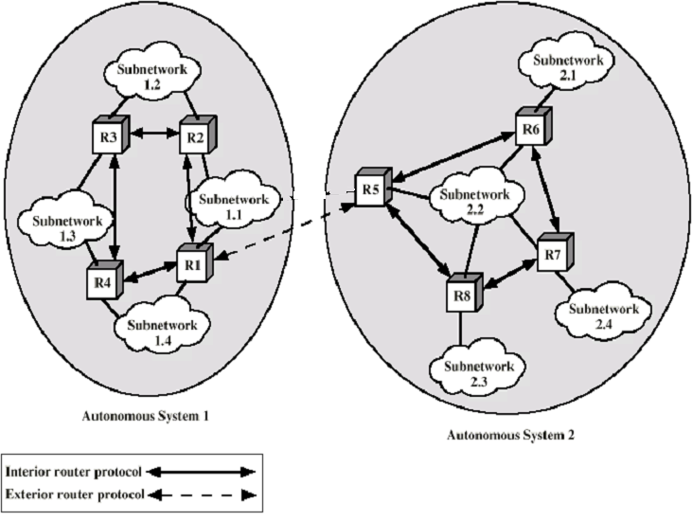
Application of IRP and ERP
Prof. D. T. Bodake(SKNCOE)

Slide 8
Intra-AS Routing
Also known as Interior Router Protocols (IRP) or Interior Gateway Protocols (IGP)
Most common:
  RIP: Routing Information Protocol
  OSPF: Open Shortest Path First
  IGRP: Interior Gateway Routing Protocol (Cisco proprietary)
Prof. D. T. Bodake(SKNCOE)

Slide 9
RIP ( Routing Information Protocol)
Distance vector algorithm
Open Standard Protocol
Classful routing protocol
Administrative Distance is 120
Distance metric: # of hops (max = 15 hops)
Distance vectors: exchanged every 30 sec via Response Message (also called advertisement)
Each advertisement: route to up to 25 destination nets
Prof. D. T. Bodake(SKNCOE)

Slide 10
RIP (Routing Information Protocol)
z
w
x
y
A
D
B
C
Destination Network Next Router Num. of hops to dest.
w A 2
y B 2
z B 7
x -- 1
…. …. ....
Routing table in D
Prof. D. T. Bodake(SKNCOE)

Slide 11
RIP: Link Failure and Recovery
If no advertisement heard after 180 sec → neighbor/link declared dead
  routes via neighbor invalidated
  new advertisements sent to neighbors
  neighbors in turn send out new advertisements (if tables changed)
  link failure info quickly propagates to entire net
Prof. D. T. Bodake(SKNCOE)

Slide 12
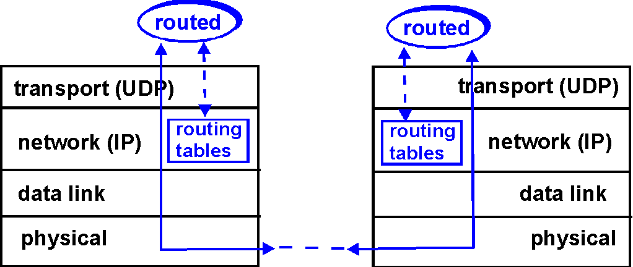
RIP Table processing
RIP routing tables managed by application-level process called route-d (daemon)
advertisements sent in UDP packets, periodically repeated
  Why UDP?
Prof. D. T. Bodake(SKNCOE)

Slide 13
RIP Table example (continued)
Router: giroflee.eurocom.fr via: netstat -rn
Destination Gateway Flags Ref Use Interface
-------------------- -------------------- ----- ----- ------ ---------
127.0.0.1 127.0.0.1 UH 0 26492 lo0
192.168.2. 192.168.2.5 U 2 13 fa0
193.55.114. 193.55.114.6 U 3 58503 le0
192.168.3. 192.168.3.5 U 2 25 qaa0
224.0.0.0 193.55.114.6 U 3 0 le0
default 193.55.114.129 UG 0 143454
Three attached class C networks (LANs)
Router only knows routes to attached LANs
Default router used to “go up”
Route multicast address: 224.0.0.0
Loopback interface (for debugging)
Prof. D. T. Bodake(SKNCOE)

Slide 14
RIP
Advantages
  Simplicity ; little to no configuration, just start routed up
  Passive version for hosts
    If a host wants to just listen and update its routing table
Packet Format
  This is in the payload of a UDP packet
0 8 16 24 31
Command(1-5) Version(2) Must be Zero
Family of Net 1 Route Tag for Net 1
IP Address of Net 1
Subnet Mask for Net 1
Next Hop for Net 1
Distance to Net 1
Family of Net 2 Route Tag for Net 2
IP Address of Net 2
…
Prof. D. T. Bodake(SKNCOE)

Slide 15
OSPF (Open Shortest Path First)
“Open”: publicly available
  RFC 2328
Uses Link State algorithm
  LS packet dissemination
  Topology map at each node
  Route computation using Dijkstra’s algorithm
OSPF advertisement carries one entry per neighbor router
Metric is cost
Administrative Distance 110
Conceived as a successor to RIP
Prof. D. T. Bodake(SKNCOE)

Slide 16
OSPF “advanced” features (not in RIP)
Security: all OSPF messages authenticated (to prevent malicious intrusion); TCP connections used
Multiple same-cost paths allowed (only one path in RIP)
For each link, multiple cost metrics for different Type Of Service (e.g., satellite link cost set “low” for best effort; high for real time)
Integrated uni- and multicast support:
  Multicast OSPF (MOSPF) uses same topology data base as OSPF
Hierarchical OSPF in large domains.
Prof. D. T. Bodake(SKNCOE)

Slide 17

Hierarchical OSPF
Prof. D. T. Bodake(SKNCOE)

Slide 18
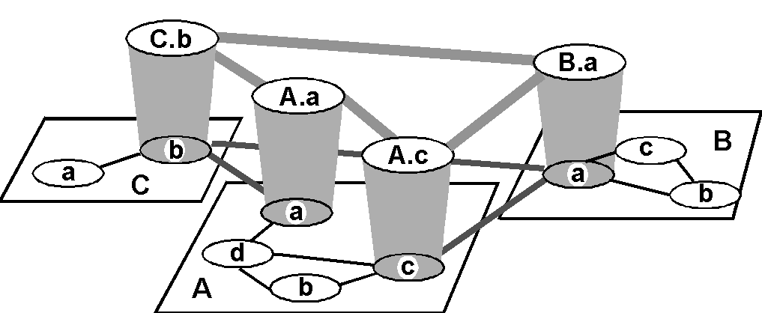
Inter-AS routing / Exterior Route Protocols
Prof. D. T. Bodake(SKNCOE)

Slide 19
Internet inter-AS/ERP routing: BGP
BGP (Border Gateway Protocol): the de facto standard
  Version 4 the current standard
Path Vector protocol:
  similar to Distance Vector protocol
  each Border Gateway broadcast to neighbors (peers) entire path (i.e, sequence of ASs) to destination
Prof. D. T. Bodake(SKNCOE)

Slide 20
BGP Terminology
Autonomous System: A collection of networks under a single administrative domain
Inter-domain Routing: Routing between the customer and the service provider
Internal Routing: Uses IGP protocol (RIP OSPF) to exchange routing information inside the AS
External Routing: Uses EGP protocol(BGP) to exchange routes between AS
IBGP: When BGP is used inside an AS
EBGP: When BGP is used between AS
Prof. D. T. Bodake(SKNCOE)

Slide 21
Autonomous System
AS is a collection of networks under a single technical administration
  16 bit numbers
  Ranging from 1 to 65535
  Private AS: 64512-65535
  1-64511: IANA
Prof. D. T. Bodake(SKNCOE)

Slide 22
Internet inter-AS routing: BGP
BGP messages exchanged using TCP.
BGP messages:
  OPEN: opens TCP connection to peer and authenticates sender
  UPDATE: advertises new path (or withdraws old)
  KEEPALIVE keeps connection alive in absence of UPDATES; also ACKs OPEN request
  NOTIFICATION: reports errors in previous msg; also used to close connection
Prof. D. T. Bodake(SKNCOE)

Slide 23
Configurations
Task 1: Perform Basic Configurations.
Configure the router / switch hostname.
Configure an EXEC mode password.
Configure a message-of-the-day banner.
Configure a password for console connections.
Configure a password for VTY connections.
Prof. D. T. Bodake(SKNCOE)

Slide 24
Configure and Activate Serial and Ethernet Addresses.
Step 1: Configure interfaces
Configure the interfaces on the routers with the IP addresses
Step 2: Verify IP addressing and interfaces.
Use the show ip interface brief command to verify that the IP addressing is correct and that the interfaces are active.
When you have finished, be sure to save the running configuration to the NVRAM of the router.
Step 3: Configure Ethernet interfaces of PC
Configure the Ethernet interfaces of PC with the IP addresses and default gateways
Step 4: Test the PC configuration by pinging the default gateway from the PC.
Prof. D. T. Bodake(SKNCOE)

Slide 25
Configure Switch hostname as LOCAL-SWITCH
hostname LOCAL-SWITCH
Configure the message of the day as "Unauthorized access is forbidden"
banner motd #
Unauthorized access is forbidden#
Configure the password for privileged mode access as "cisco". The password must be md5 encrypted
enable secret cisco
Configure password encryption on the switch using the global configuration command
service password-encryption
Configure CONSOLE access [...]
line con 0
password ciscoconsole
logging synchronous
login
Configure TELNET access [...]
line vty 0 15
exec-timeout 8 20
password ciscotelnet
logging synchronous
login
history size 15
Configure the IP address of the switch as 192.168.1.2/24 and it's default gateway IP (192.168.1.1).
interface Vlan1
ip address 192.168.1.2 255.255.255.0
ip default-gateway 192.168.1.1
Prof. D. T. Bodake(SKNCOE)

Slide 26
Router Configuration
enable
configure terminal
hostname RanetA
enable secret ranetenablepass
line con 0
password ranetenablepass
login
end
configure terminal
ranetenablepass
configure terminal
line vty 0 4
password ranettelnetpass
exit
interface fastethernet 0/0
ip address 10.0.0.1 255.255.255.252
exit
interface fastethernet 0/1
ip address 192.168.0.254 255.255.255.192
exit
interface fastethernet 0/0
no shutdown
exit
interface fastethernet 0/1
no shutdown
exit
exit
exit
Prof. D. T. Bodake(SKNCOE)

Slide 27
Configure RIP.
Step 1: Enable dynamic routing.
To enable a dynamic routing protocol, enter global configuration mode and use the router command.
Enter router ? at the global configuration prompt to a see a list of available routing protocols on your router.
To enable RIP, enter the command router rip in global configuration mode.
R1(config)#router rip
R1(config-router)#
Step 2: Enter classful network addresses.
Once you are in routing configuration mode, enter the classful network address for each directly
connected network, using the network command.
R1(config-router)#network 192.168.1.0
R1(config-router)#network 192.168.2.0
Prof. D. T. Bodake(SKNCOE)

Slide 28
Configure OSPF
R1(config)# router ospf 1
R1(config-router)# network 10.10.30.0 0.0.0.255 area 0
R1(config-router)# network 172.16.0.0 0.0.0.3 area 0
R1(config-router)# network 192.168.0.0 0.0.0.255 area 0
Prof. D. T. Bodake(SKNCOE)

Slide 29
Configure BGP
IOS commands available in Packet Tracer 6.0
Enable mode
  show ip bgp
  show ip bgp neighbors
  show ip bgp summary
  clear ip bgp *
Router bgp mode
  log-neighbor-changes
  redistribute-internal
  router-id A.B.C.D
  exit
neighbor A.B.C.D next-hop-self
neighbor A.B.C.D remote-as <1-65535>
network A.B.C.D
network A.B.C.D mask A.B.C.D
Prof. D. T. Bodake(SKNCOE)

Slide 30
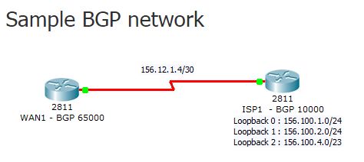
Router WAN1 configuration :
interface Serial0/0/0
ip address 156.12.1.6 255.255.255.252
!
router bgp 65000
bgp log-neighbor-changes
no synchronization
neighbor 156.12.1.5 remote-as 10000
Router ISP1 configuration :
interface Loopback0
ip address 156.100.1.1 255.255.255.0
!
interface Loopback1
ip address 156.100.2.1 255.255.255.0
!
interface Loopback2
ip address 156.100.4.1 255.255.254.0
!
interface Serial0/0/0
ip address 156.12.1.5 255.255.255.252
clock rate 500000
!
router bgp 10000
bgp log-neighbor-changes
no synchronization
neighbor 156.12.1.6 remote-as 65000
network 156.100.4.0 mask 255.255.254.0
network 156.100.2.0 mask 255.255.255.0
network 156.100.1.0 mask 255.255.255.0
!
Prof. D. T. Bodake(SKNCOE)

